Slide 1
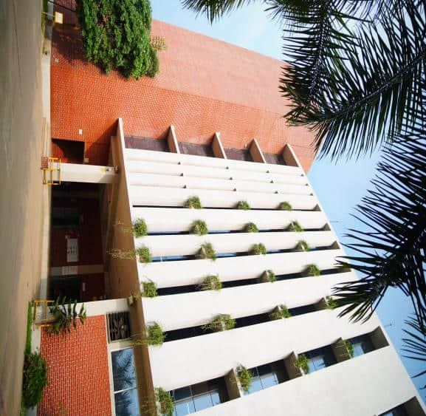

MNR DESIGN LTD.

Slide 2
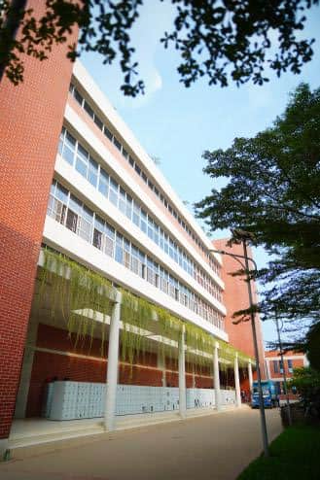
Table of Contents
01
About Company
Vision & Mission
Our Customers
Our top Customers
Certifications
Quality Control SOP
Machineries & Capacity
Factory Overview
Our Products
Sustainability
Contacts
02
03
04
05
06
07
08
09
10
11

Slide 3
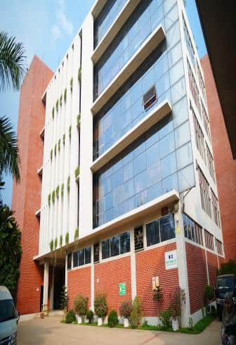
ABOUT US
MNR Design is one of the leading sweater manufacturing company since its inauguration in 2018. It has demonstrated its full commitment towards delivering quality products and services that enabled the organization surpass the expectation of its customers across the world. The organization’s client base includes renowned international retailers and the biggest brands of the apparel industry.
We are offering wide product range to the valuable clients, which is the biggest strength of this Organization. MNR Design is producing 100% Cashmere wool, 100% Merino wool, 100% Lamb’s wool and wool blend products beside local and imported fancy yarn with join life. We are able to produce all kinds of jacquard knitting including intarsia in a short lead time.
MNR Design has created a prominent identity for itself in the garments sector of the world by keeping commitments to our valuable clients. We believe in hiring passion and always welcome who are passionate on the apparel industry and have enthusiasm to add value in MNR family.

Slide 4



OUR VISION
Sustainability & Ethical Manufacturing
Customer-Centric Approach
Innovation & Growth
Global Excellence
To be a globally recognized leader in high-quality sweater manufacturing, providing innovative designs and premium craftsmanship while ensuring customer satisfaction.
To revolutionize the sweater manufacturing industry in Bangladesh by adopting sustainable practices, ethical labor standards, and eco-friendly production methods.
To consistently exceed customer expectations by delivering stylish, comfortable, and durable sweaters tailored to global fashion trends.
To drive innovation in the sweater industry by leveraging advanced technology, skilled craftsmanship, and efficient production processes for long-term growth and success.

Slide 5


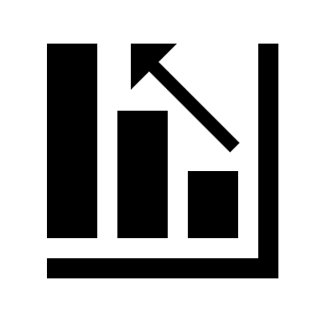

OUR MISSION
Eco-Friendly Practices
To integrate advanced manufacturing technologies and streamlined processes, ensuring efficiency, productivity, and cost-effectiveness.
Technology & Efficiency
To maintain fair wages, safe working conditions, and skill development programs, empowering our employees and supporting the local community.
Workforce Development
To adopt sustainable production methods, reduce waste, and use eco-friendly materials, contributing to a greener and more responsible fashion industry.

Slide 6
OUR CUSTOMERS
CARREFOUR
S'OLIVER
ECI
OVS
NKD
JUST GROUP
WALMART
K-MART Australia
TESCO
SAINSBURRY
DUNNES
GEORGE
WEATHER PROOF
DKNY
BEN SHERMIN
KENNETH COLE
COSTCO
CHAPS
GAZZARRINI
INDITEX
NEXT
US POLO
MATALAN
ALDI
PRIMARK
LIDL

Slide 7
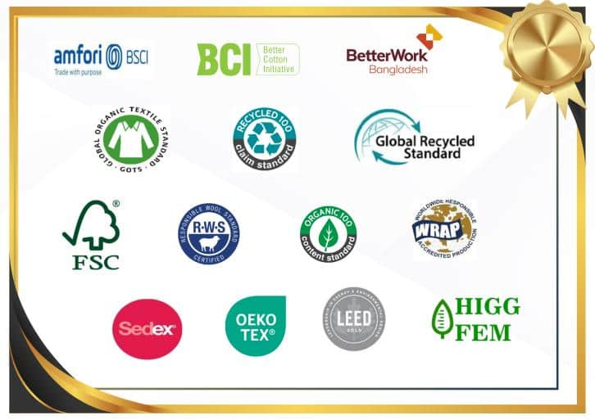
CERTIFICATIONS

Slide 8
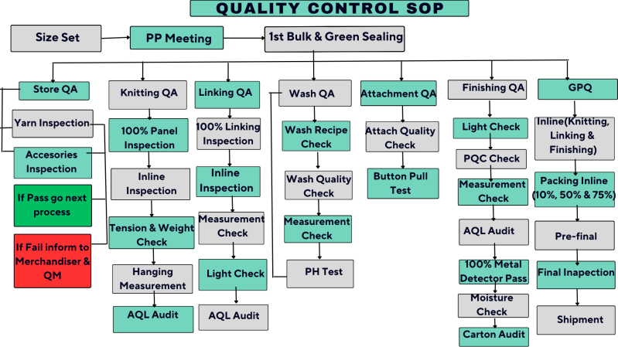
QUALITY CONTROL SOP

Slide 9
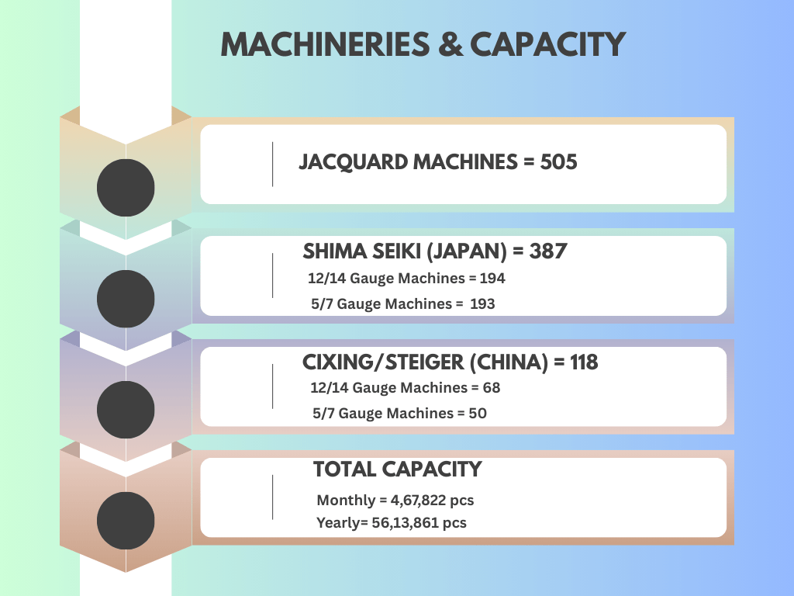

Slide 10
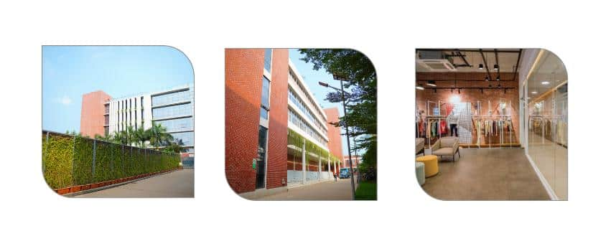
FACTORY OVERVIEW

Slide 11
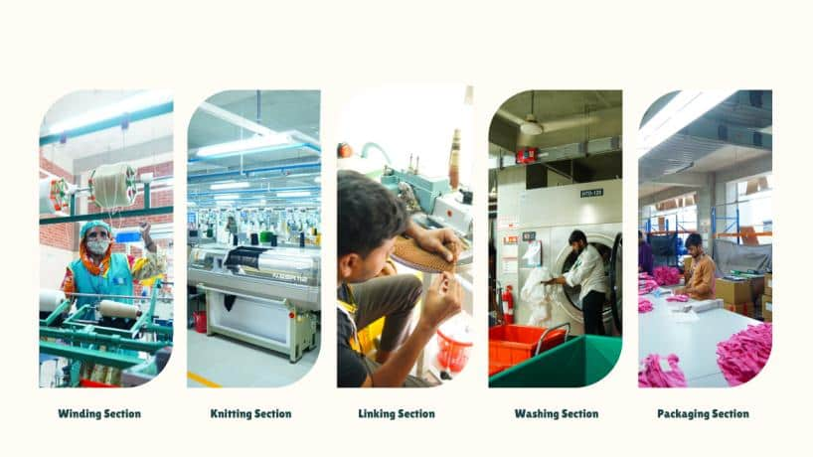
FACTORY OVERVIEW

Slide 12
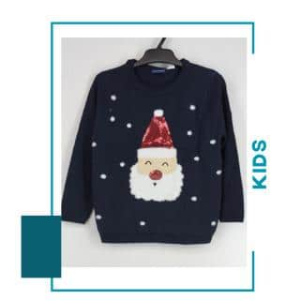
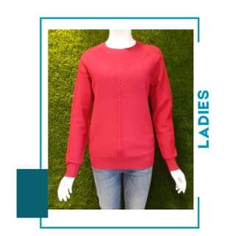
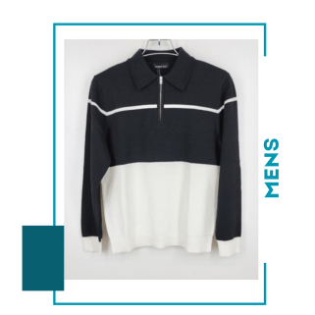
OUR PRODUCTS

Slide 13


SUSTAINABILITY
Ensure Buyer Satisfaction
Capacity with Short Lead-Time
On Time Delivery & Shipment.
Provide fair wages and safe working conditions for all employees.
Highly Conscious in Environment in LEED with Gold Certification
Implement a zero-waste policy in production.
Utilize water-efficient dyeing and finishing processes.
Create green spaces around the factory for biodiversity and employee well-being.

Slide 14
CONTACTS
Get in touch with us
Bank Details
Contact 1
Name: Golam Mostofa
Managing Director
Phone: +880 1929913111
E-mail: mostofa@mnrgroupbd.com
Mercantile Bank Ltd.
Gulshan Branch,106 Gulshan Avenue.
Dhaka 1212,Bangladesh.
Phone #+880-028835276
Fax # +880-02-8835614.
SWIFT: MBLBBDDH019
Address
Contact 2
Name: Md . Rafiqul Islam
General Manager
(Marketing & Merchandising)
Cell : +880 1929913150
E-mail : rafique@mnrgroupbd.com
Corporate Office :
House :488 (1st & 2nd Floor),Road: 8,
Baridhara DOHS,Dhaka-1206.
Factory Office :
Baraider Chala, Sreepur, Gazipur,
Bangladesh.

Slide 15


